Slide 1
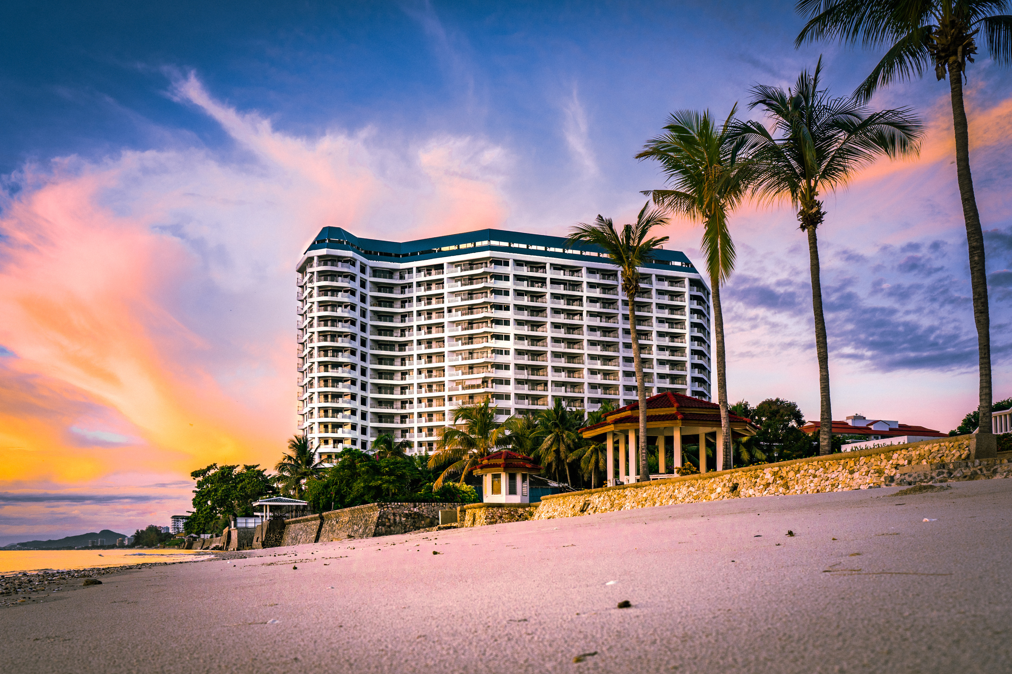

PROJECT
Hotel Reservation analysis in SQL
DATA ANALYST
CASMIR ORORI

Slide 2

PROJECT OVERVIEW
The hotel industry relies on data to make informed decisions and provide a better guest experience. The hotel reservation dataset helps us to gain insights into guest preferences,
booking trends, and other key factors that impact the hotel's operations.SQL was used to query and
analyze the data, as well as answer specific questions about the dataset.

Slide 3
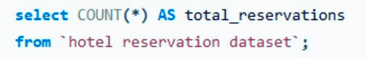
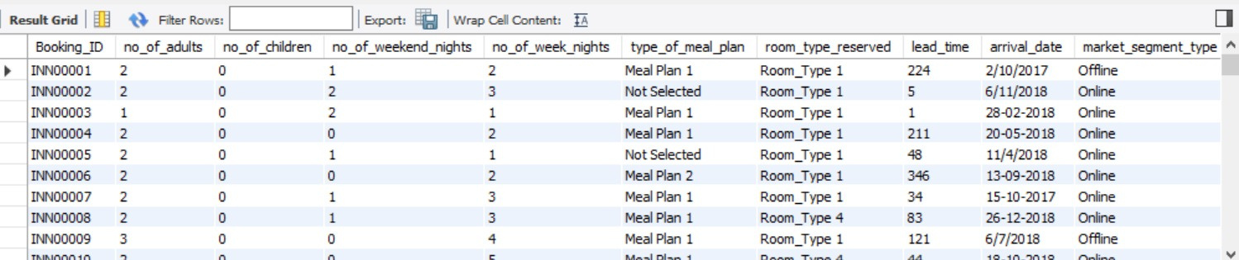
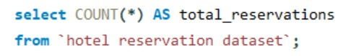
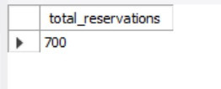
DATASET
Q1. What is the total number of reservations in the dataset
from the query we get atleast 700 reservations were made

Slide 4
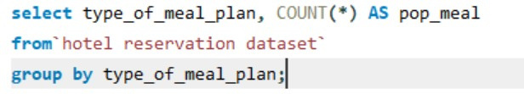
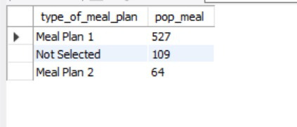
Q2. Which meal plan is the most popular among guests?
Meal plan 1 is preffered by most guests as it leads with 527

Slide 5
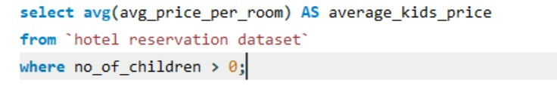
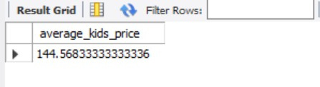
Q3.What is the average price per room for reservations involving children?
the average price per room with children is 144.568

Slide 6
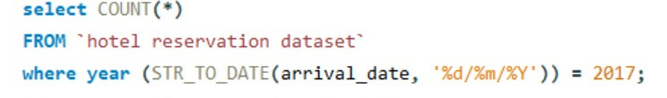
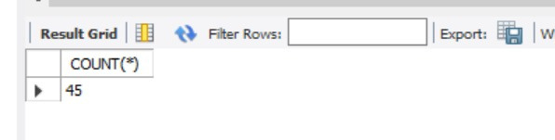
Q4. How many reservations were made for the year 20XX (replace XX with the desired year)?
NB///STR_TO_DATE(arrival_date, '%d/%m/%Y')) = 2017;
there were 45 reservations in 2017

Slide 7
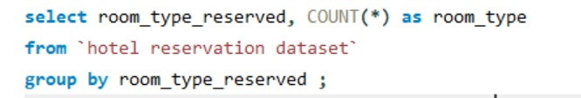
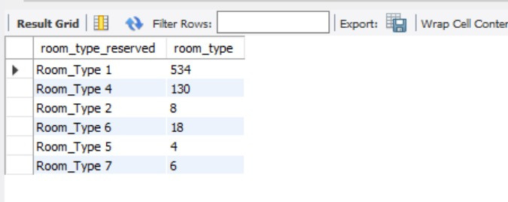
Q5. What is the most commonly booked room type?
room type 1 leads with 534 reservations

Slide 8
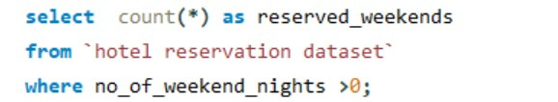
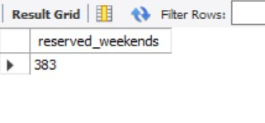
Q6. How many reservations fall on a weekend (no_of_weekend_nights > 0)?
there 383 reserved weekends

Slide 9
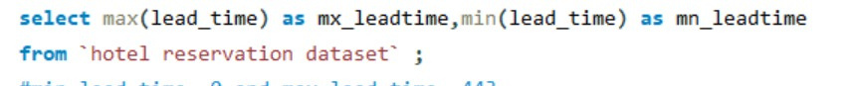
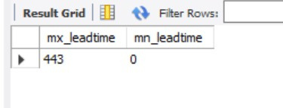
Q7. What is the highest and lowest lead time for reservations
max lead time was 443 and minimum was 0

Slide 10
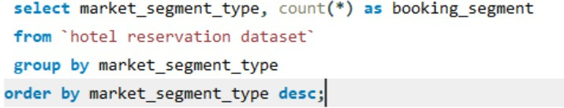
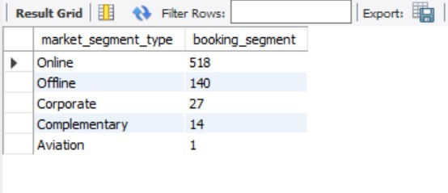
Q8. What is the most common market segment type for reservations?
online segment leads

Slide 11
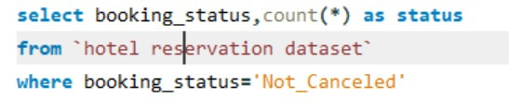
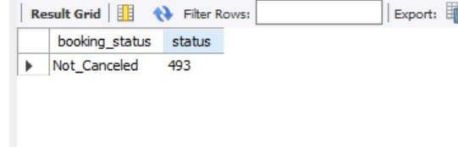
q.9How many reservations have a booking status of "Confirmed"?
there were 0 confirmed status but 493 did not cancel their reservations

Slide 12
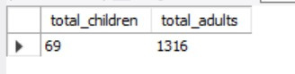
Q10. What is the total number of adults and children across all reservations?
69 chldren and 1316 adults across alll reservations

Slide 13
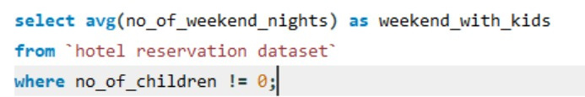
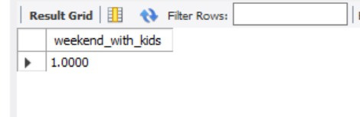
Q11. What is the average number of weekend nights for reservations involving children?
the average is 1

Slide 14
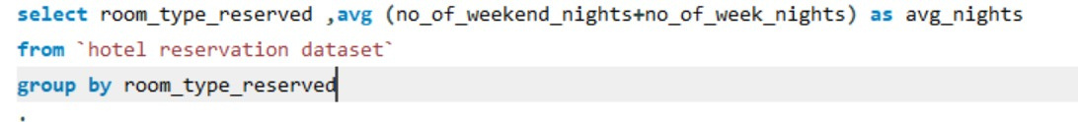
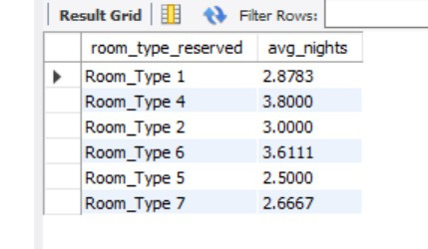
Q13. What is the average number of nights spent by guests for each room type?
the most common room type is type 1 with avg _nights of 3

Slide 15
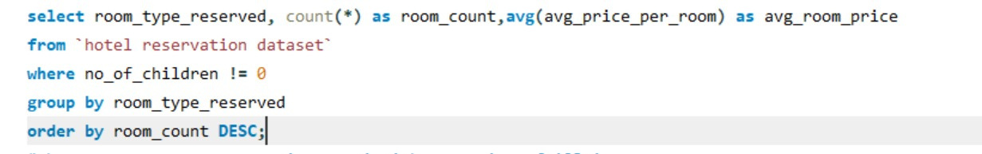
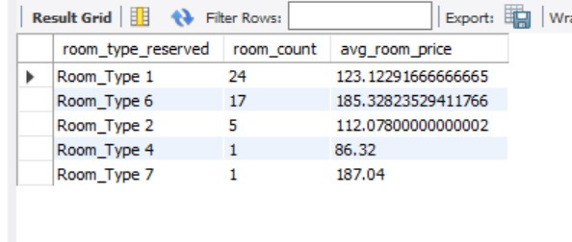
Q14. For reservations involving children, what is the most common room type, and what is the average price for that room type?

Slide 16
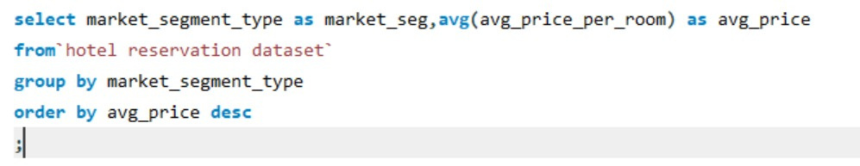
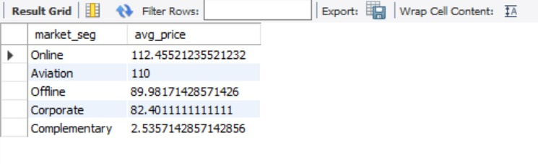
Q15. Find the market segment type that generates the highest average price per room.
online leads with 112.45

Slide 17
CONCLUSION
The hotel needs to implement strategies such as flexible booking policies for it to reduce the number of cancellations
Offer personalized services like guest experiences inorder to enhance guest experience.
Adjust rates of rooms based on demand , room type and popularity.
O

Slide 18



